Slide 1
Murach’s PHP and MySQL (4th Edition)
Chapter 5
How to use
the MVC pattern
to organize your code

Slide 2
Applied objectives
Use the MVC pattern to develop your web applications.
Create and use functions that do the database processing for the model of your MVC applications.
Use the built-in header function to redirect HTTP requests.
Use the Post-Redirect-Get (PRG) pattern to prevent users from resubmitting a POST request.

Slide 3
Knowledge objectives
Describe the Model-View-Controller pattern.
Explain how the MVC pattern can improve application development.
In general terms, describe the code for creating and calling a function.
Distinguish between forwarding an HTTP request and redirecting a request.
Explain how the PRG pattern prevents users from resubmitting a POST request.

Slide 4
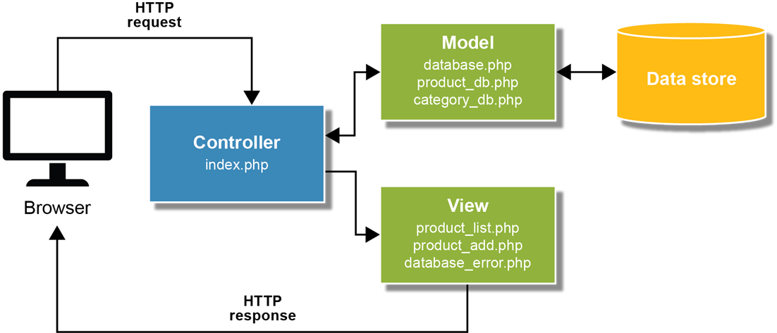
The MVC pattern

Slide 5
Key terms for the MVC Pattern
Model-View-Controller (MVC) pattern
model
view
controller

Slide 6
The syntax for coding a function
function function_name([parameter_list]) {
// statements that are executed by the function
}
A function with one parameter that returns
an array of products
function get_products_by_category($category_id) {
global $db;
$query = 'SELECT * FROM products
WHERE categoryID = :category_id
ORDER BY productID';
$statement = $db->prepare($query);
$statement->bindValue(':category_id', $category_id);
$statement->execute();
$products = $statement->fetchAll();
$statement->closeCursor();
return $products;
}

Slide 7
A function with four parameters that adds a product
function add_product($category_id, $code, $name, $price) {
global $db;
$query = 'INSERT INTO products
(categoryID, productCode, productName, listPrice)
VALUES
(:category_id, :code, :name, :price)';
$statement = $db->prepare($query);
$statement->bindValue(':category_id', $category_id);
$statement->bindValue(':code', $code);
$statement->bindValue(':name', $name);
$statement->bindValue(':price', $price);
$statement->execute();
$statement->closeCursor();
}

Slide 8
A function call with one argument and a returned array
$products = get_products_by_category($category_id);
A function call with four arguments
and no returned value
add_product($category_id, $code, $name, $price);

Slide 9
Key terms for using functions
parameter list
parameter
return statement
scope
global keyword

Slide 10
A built-in function for redirecting a request
header($header)
The header function
header('Location: .'); // the current directory
header('Location: ..'); // up one directory
header('Location: ./admin'); // down one directory
header('Location: error.php');
header('Location: http://www.murach.com/');
How to redirect a request
if ($action == 'delete_product') {
$product_id = filter_input(INPUT_POST, 'product_id',
FILTER_VALIDATE_INT);
if ($product_id != NULL && $product_id != FALSE) {
delete_product($product_id);
header("Location: .");
}
}

Slide 11
How to redirect a request that includes a parameter
if ($action == 'delete_product') {
$product_id = filter_input(INPUT_POST, 'product_id',
FILTER_VALIDATE_INT);
$category_id = filter_input(INPUT_POST, 'category_id',
FILTER_VALIDATE_INT);
if ($category_id != NULL && $category_id != FALSE &&
$product_id != NULL && $product_id != FALSE) {
delete_product($product_id);
header("Location: .?category_id=$category_id");
}
}

Slide 12
Key terms for working with requests
forward a request
redirect a request

Slide 13
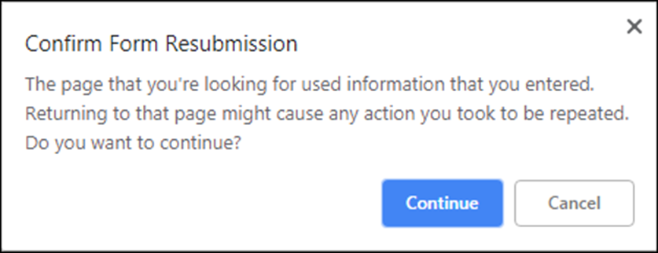
Code that responds to a POST request
if ($action == 'delete_product') {
$product_id = filter_input(INPUT_POST, 'product_id',
FILTER_VALIDATE_INT);
if ($product_id != NULL && $product_id != FALSE) {
delete_product($product_id);
include('view/product_list.php');
}
}
A message that’s displayed when you refresh
the page and resubmit the request

Slide 14
How to use the PRG (Post-Redirect-Get) pattern to avoid resubmission of the POST request
if ($action == 'delete_product') {
$product_id = filter_input(INPUT_POST, 'product_id',
FILTER_VALIDATE_INT);
if ($product_id != NULL && $product_id != FALSE) {
delete_product($product_id);
// redirect to the current directory
header("Location: .");
}
}

Slide 15
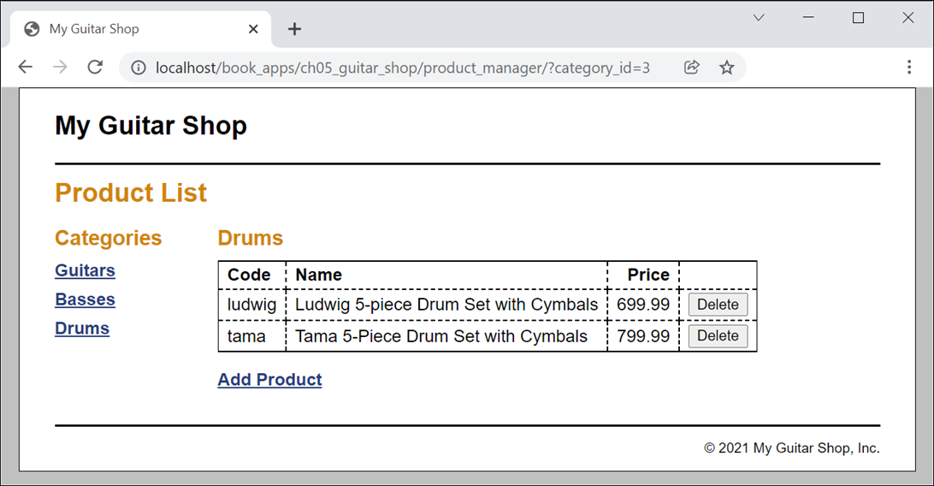
Product Manager application: Product List page

Slide 16
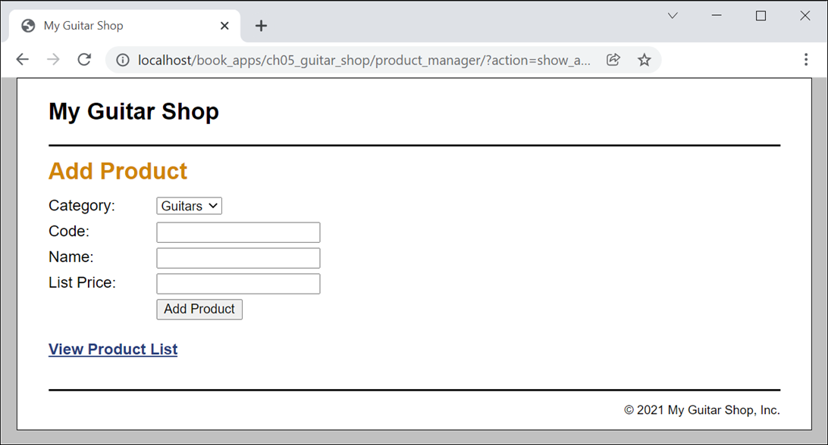
Product Manager application: Add Product page

Slide 17
Product Manager: model/category_db.php
<?php
function get_categories() {
global $db;
$query = 'SELECT * FROM categories
ORDER BY categoryID';
$statement = $db->prepare($query);
$statement->execute();
$categories = $statement->fetchAll();
$statement->closeCursor();
return $categories;
}
function get_category_name($category_id) {
global $db;
$query = 'SELECT * FROM categories
WHERE categoryID = :category_id';
$statement = $db->prepare($query);
$statement->bindValue(':category_id', $category_id);
$statement->execute();
$category = $statement->fetch();
$statement->closeCursor();
$category_name = $category['categoryName'];
return $category_name;
}
?>

Slide 18
Product Manager: model/product_db.php (part 1)
<?php
function get_products_by_category($category_id) {
global $db;
$query = 'SELECT * FROM products
WHERE categoryID = :category_id
ORDER BY productID';
$statement = $db->prepare($query);
$statement->bindValue(':category_id', $category_id);
$statement->execute();
$products = $statement->fetchAll();
$statement->closeCursor();
return $products;
}
function get_product($product_id) {
global $db;
$query = 'SELECT * FROM products
WHERE productID = :product_id';
$statement = $db->prepare($query);
$statement->bindValue(':product_id', $product_id);
$statement->execute();
$product = $statement->fetch();
$statement->closeCursor();
return $product;
}

Slide 19
Product Manager: model/product_db.php (part 2)
function delete_product($product_id) {
global $db;
$query = 'DELETE FROM products
WHERE productID = :product_id';
$statement = $db->prepare($query);
$statement->bindValue(':product_id', $product_id);
$statement->execute();
$statement->closeCursor();
}
function add_product($category_id, $code, $name, $price) {
global $db;
$query = 'INSERT INTO products
(categoryID, productCode, productName, listPrice)
VALUES
(:category_id, :code, :name, :price)';
$statement = $db->prepare($query);
$statement->bindValue(':category_id', $category_id);
$statement->bindValue(':code', $code);
$statement->bindValue(':name', $name);
$statement->bindValue(':price', $price);
$statement->execute();
$statement->closeCursor();
}
?>

Slide 20
Controller: product_manager/index.php (part 1)
<?php
require('../model/database.php');
require('../model/product_db.php');
require('../model/category_db.php');
$action = filter_input(INPUT_POST, 'action');
if ($action == NULL) {
$action = filter_input(INPUT_GET, 'action');
if ($action == NULL) {
$action = 'list_products';
}
}
if ($action == 'list_products') {
$category_id = filter_input(INPUT_GET, 'category_id',
FILTER_VALIDATE_INT);
if ($category_id == NULL || $category_id == FALSE) {
$category_id = 1;
}
$category_name = get_category_name($category_id);
$categories = get_categories();
$products = get_products_by_category($category_id);
include('product_list.php');

Slide 21
Controller: product_manager/index.php (part 2)
} else if ($action == 'delete_product') {
$product_id = filter_input(INPUT_POST, 'product_id',
FILTER_VALIDATE_INT);
$category_id = filter_input(INPUT_POST, 'category_id',
FILTER_VALIDATE_INT);
if ($category_id == NULL || $category_id == FALSE ||
$product_id == NULL || $product_id == FALSE) {
$error = "Missing or incorrect product id or category id.";
include('../errors/error.php');
} else {
delete_product($product_id);
header("Location: .?category_id=$category_id");
}
} else if ($action == 'show_add_form') {
$categories = get_categories();
include('product_add.php');

Slide 22
Controller: product_manager/index.php (part 3)
} else if ($action == 'add_product') {
$category_id = filter_input(INPUT_POST, 'category_id',
FILTER_VALIDATE_INT);
$code = filter_input(INPUT_POST, 'code');
$name = filter_input(INPUT_POST, 'name');
$price = filter_input(INPUT_POST, 'price',
FILTER_VALIDATE_FLOAT);
if ($category_id == NULL || $category_id == FALSE ||
$code == NULL || $name == NULL ||
$price == NULL || $price == FALSE) {
$error = "Invalid product data. ";
$error += "Check all fields and try again.";
include('../errors/error.php');
} else {
add_product($category_id, $code, $name, $price);
header("Location: .?category_id=$category_id");
}
}
?>

Slide 23
Product Manager: view/header.php
<!DOCTYPE html>
<html>
<!-- the head section -->
<head>
<title>My Guitar Shop</title>
<link rel="stylesheet"
href="/book_apps/ch05_guitar_shop/main.css">
</head>
<!-- the body section -->
<body>
<header>
<h1>My Guitar Shop</h1>
</header>

Slide 24
Product Manager: view/footer.php
<footer>
<p class="copyright">
&copy; <?php echo date('Y'); ?> My Guitar Shop, Inc.
</p>
</footer>
</body>
</html>

Slide 25
A view: product_manager/product_list.php (part 1)
<?php include '../view/header.php'; ?>
<main>
<h1>Product List</h1>
<aside>
<!-- display a list of categories -->
<h2>Categories</h2>
<nav>
<ul>
<?php foreach ($categories as $category) : ?>
<li>
<a href="?category_id=<?php
echo $category['categoryID']; ?>">
<?php echo $category['categoryName']; ?>
</a>
</li>
<?php endforeach; ?>
</ul>
</nav>
</aside>

Slide 26
A view: product_manager/product_list.php (part 2)
<section>
<!-- display a table of products -->
<h2><?php echo $category_name; ?></h2>
<table>
<tr>
<th>Code</th>
<th>Name</th>
<th class="right">Price</th>
<th>&nbsp;</th>
</tr>
<?php foreach ($products as $product) : ?>
<tr>
<td><?php echo $product['productCode']; ?></td>
<td><?php echo $product['productName']; ?></td>
<td class="right"><?php
echo $product['listPrice']; ?></td>

Slide 27
A view: product_manager/product_list.php (part 3)
<td><form action="." method="post">
<input type="hidden" name="action"
value="delete_product">
<input type="hidden" name="product_id"
value="<?php
echo $product['productID']; ?>">
<input type="hidden" name="category_id"
value="<?php
echo $product['categoryID']; ?>">
<input type="submit" value="Delete">
</form></td>
</tr>
<?php endforeach; ?>
</table>
<p class="last_paragraph">
<a href="index.php?action=show_add_form">Add Product</a>
</p>
</section>
</main>
<?php include '../view/footer.php'; ?>

Slide 28
Another view: product_manager/product_add.php (part 1)
<?php include '../view/header.php'; ?>
<main>
<h1>Add Product</h1>
<form action="." method="post" id="add_product_form">
<input type="hidden" name="action" value="add_product">
<label>Category:</label>
<select name="category_id">
<?php foreach ( $categories as $category ) : ?>
<option value="<?php echo $category['categoryID']; ?>">
<?php echo $category['categoryName']; ?>
</option>
<?php endforeach; ?>
</select>
<br>
<label>Code:</label>
<input type="text" name="code" />
<br>

Slide 29
Another view: product_manager/product_add.php (part 2)
<label>Name:</label>
<input type="text" name="name" />
<br>
<label>List Price:</label>
<input type="text" name="price" />
<br>
<label>&nbsp;</label>
<input type="submit" value="Add Product" />
<br>
</form>
<p class="last_paragraph">
<a href="?action=list_products">View Product List</a>
</p>
</main>
<?php include '../view/footer.php'; ?>

Slide 30
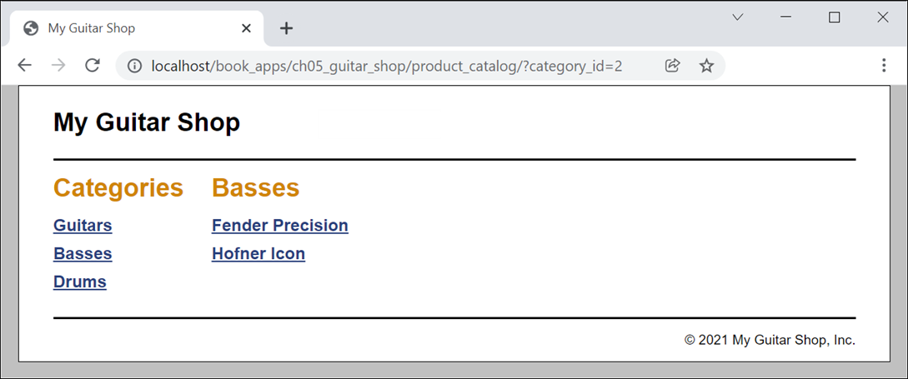
Product Catalog application: Product List page

Slide 31
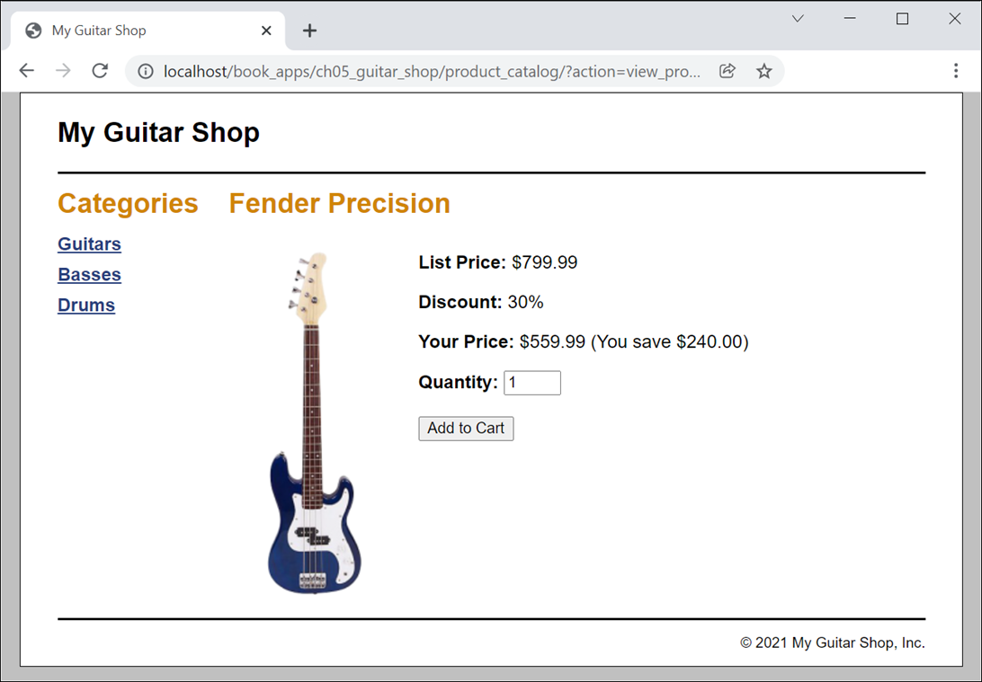
Product Catalog application: Product page

Slide 32
Controller: product_catalog/index.php (part 1)
<?php
require('../model/database.php');
require('../model/product_db.php');
require('../model/category_db.php');
$action = filter_input(INPUT_POST, 'action');
if ($action == NULL) {
$action = filter_input(INPUT_GET, 'action');
if ($action == NULL) {
$action = 'list_products';
}
}

Slide 33
Controller: product_catalog/index.php (part 2)
if ($action == 'list_products') {
$category_id = filter_input(INPUT_GET, 'category_id',
FILTER_VALIDATE_INT);
if ($category_id == NULL || $category_id == FALSE) {
$category_id = 1;
}
$categories = get_categories();
$category_name = get_category_name($category_id);
$products = get_products_by_category($category_id);
include('product_list.php');

Slide 34
Controller: product_catalog/index.php (part 3)
} else if ($action == 'view_product') {
$product_id = filter_input(INPUT_GET, 'product_id',
FILTER_VALIDATE_INT);
if ($product_id == NULL || $product_id == FALSE) {
$error = 'Missing or incorrect product id.';
include('../errors/error.php');
} else {
$categories = get_categories();
$product = get_product($product_id);
// Get product data
$code = $product['productCode'];
$name = $product['productName'];
$list_price = $product['listPrice'];
// Calculate discounts
$discount_percent = 30; // 30% off for all web orders
$discount_amount =
round($list_price * ($discount_percent/100.0), 2);
$unit_price = $list_price - $discount_amount;

Slide 35
Controller: product_catalog/index.php (part 4)
// Format the calculations
$discount_amount_f = number_format($discount_amount, 2);
$unit_price_f = number_format($unit_price, 2);
// Get image URL and alternate text
$image_filename = '../images/' . $code . '.png';
$image_alt = 'Image: ' . $code . '.png';
include('product_view.php');
}
}
?>

Slide 36
A view: product_catalog/product_list.php (part 1)
<?php include '../view/header.php'; ?>
<main>
<aside>
<h1>Categories</h1>
<nav>
<ul>
<!-- display links for all categories -->
<?php foreach($categories as $category) : ?>
<li>
<a href="?category_id=<?php
echo $category['categoryID']; ?>">
<?php echo $category['categoryName']; ?>
</a>
</li>
<?php endforeach; ?>
</ul>
</nav>
</aside>

Slide 37
A view: product_catalog/product_list.php (part 2)
<section>
<h1><?php echo $category_name; ?></h1>
<nav>
<ul>
<!-- display links for products in selected category -->
<?php foreach ($products as $product) : ?>
<li>
<a href="?action=view_product&amp;product_id=<?php
echo $product['productID']; ?>">
<?php echo $product['productName']; ?>
</a>
</li>
<?php endforeach; ?>
</ul>
</nav>
</section>
</main>
<?php include '../view/footer.php'; ?>

Slide 38
Another view: product_catalog/product_view.php (part 1)
<?php include '../view/header.php'; ?>
<main>
<aside>
<h1>Categories</h1>
<nav>
<ul>
<!-- display links for all categories -->
<?php foreach($categories as $category) : ?>
<li>
<a href="?category_id=<?php
echo $category['categoryID']; ?>">
<?php echo $category['categoryName']; ?>
</a>
</li>
<?php endforeach; ?>
</ul>
</nav>
</aside>

Slide 39
Another view: product_catalog/product_view.php (part 2)
<section>
<h1><?php echo $name; ?></h1>
<div id="left_column">
<p>
<img src="<?php echo $image_filename; ?>"
alt="<?php echo $image_alt; ?>" />
</p>
</div>
<div id="right_column">
<p><b>List Price:</b> $<?php echo $list_price; ?></p>
<p><b>Discount:</b>
<?php echo $discount_percent; ?>%</p>
<p><b>Your Price:</b> $<?php echo $unit_price_f; ?>
(You save $<?php echo $discount_amount_f; ?>)</p>

Slide 40
Another view: product_catalog/product_view.php (part 3)
<form action="<?php echo '../cart' ?>" method="post">
<input type="hidden" name="action" value="add">
<input type="hidden" name="product_id"
value="<?php echo $product_id; ?>">
<b>Quantity:</b>
<input id="quantity" type="text" name="quantity"
value="1" size="2">
<br><br>
<input type="submit" value="Add to Cart">
</form>
</div>
</section>
</main>
<?php include '../view/footer.php'; ?>

